Slide 1
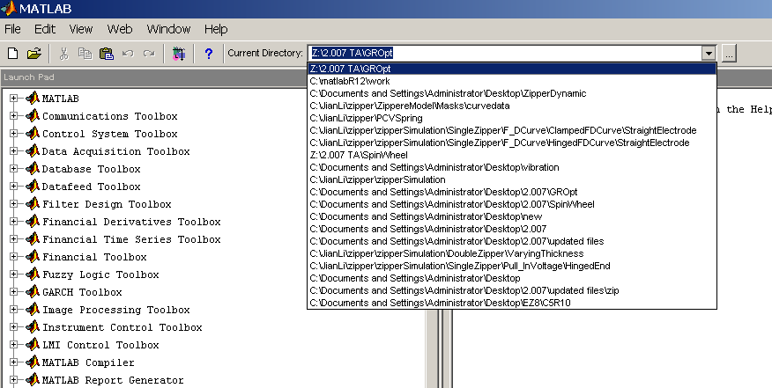
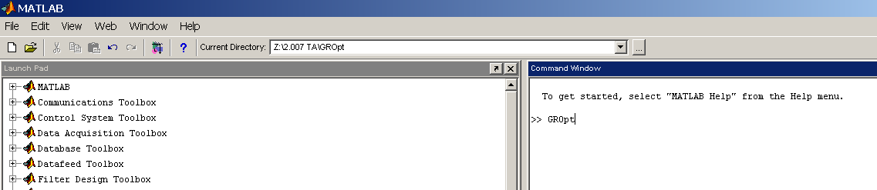
GROpt.m (1)
Copy the 7 files from GRopt.zip into one directory.
2. Set current directory in MATLAB (Fig. 1) to the one where you have copied the above files to.
3. In MATLAB command window, type in the command “GROpt” (Fig.2), bring up the visual interface shown in next page.
Fig. 1: Set Current Directory in MATLAB
Fig. 2: Run “GROpt” in command window

Slide 2
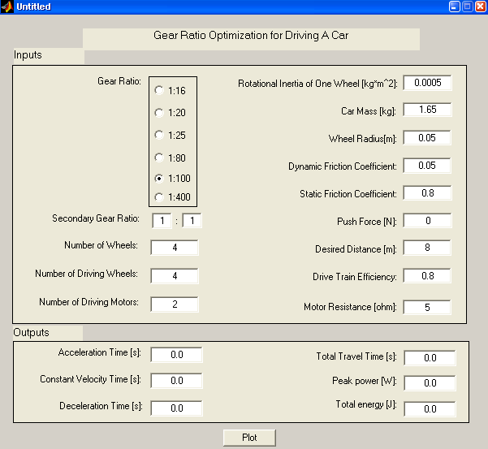
GROpt.m (2)
Refer to Fig. 3:
4. In the “Inputs” area, choose the gear ratio you want to use.
5. Fill in all of the parameters for your car:
-- In “Desired Distance”, fill in the distance that the car is planned to run.
--Determine the “Drive Chain Efficiency” experimentally.
Fig. 3: “GROpt.m” interface

Slide 3
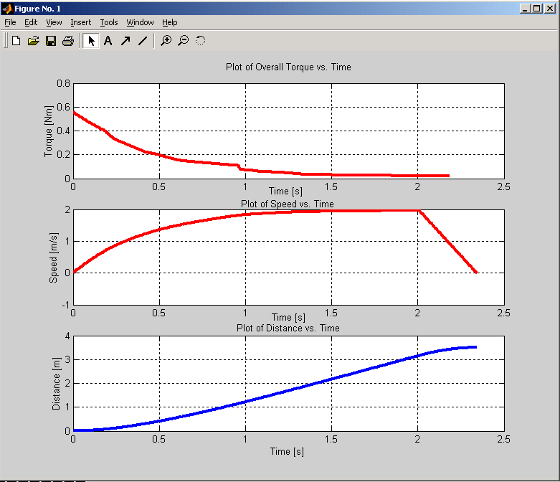
GROpt.m (3)
6. Click on the "Plot" Button (Fig. 3). Three charts - “Torque/ Speed/ Distance vs. Time will be plotted (Fig. 4).
7. Trying different gear ratios and car parameters, pick the optimal gear train ratio that gives shortest time for a desired distance.
Fig. 4: Plots from “GROpt.m”

